Slide 1


Domain Oriented Case Study – Telecom churn Case study
by
Akshay Tula
S Ravisasank Reddy

Slide 2
Problem Statement
In telecom, annual churn rates range from 15-25%. Industry shifts focus to retaining high-value customers, amid intense competition and acquisition costs.
Questions to be Answered
Define Business Objective: Predict churn in the ninth month using data from the preceding three months (June, July, August).
Analyze Customer Behavior: Understand the three phases of the customer lifecycle - 'good', 'action', and 'churn' phases. Identify high-churn-risk customers during the 'action' phase for proactive intervention.
Data Preprocessing: Encode months (June, July, August, September) as 6, 7, 8, and 9 respectively. Tag churn based on the 'churn' phase and discard corresponding data for prediction.
Predictive Modeling: Utilize features from the 'good' and 'action' phases to build predictive models for churn in the ninth month, focusing on high-value customers' behavior during churn.

Slide 3
Strategy Applied : Data Preparation
1.High-Value Customer Selection: Utilize the 70th percentile of average recharge amounts in the first two months to filter high-value customers, ensuring a focused analysis on those likely to generate significant revenue.
2.Churn Identification: Identify churners by observing specific criteria such as no call activity and zero mobile internet usage in the fourth month, enabling precise tagging of customers at risk of churn.
3.Data Filtering: Eliminate attributes related to the churn phase (month 9) to streamline the dataset and concentrate analysis on relevant 'good' and 'action' phases, optimizing predictive modeling efforts.
4.Data Preprocessing: Implement essential data preparation techniques such as feature engineering and handling missing values to enhance the dataset's quality and suitability for predictive modeling tasks.

Slide 4
Strategy Applied : Modelling
Dual-Purpose Predictive Modeling: Construct models to predict high-value customer churn, enabling proactive actions such as personalized offers or discounts, while also identifying key churn predictors for insights into customer behavior.
Class Imbalance Handling: Address the challenge of class imbalance (typically 5-10%) in churn prediction models by employing techniques to balance the representation of churners and non-churners.
Attribute Importance Identification: Develop additional models, such as logistic regression or tree-based models, to uncover significant predictor attributes indicative of churn. Ensure consideration of multicollinearity issues in logistic regression.
Visual Representation of Insights: Present findings visually through plots and summary tables to effectively communicate the importance of predictor attributes, aiding decision-makers in understanding churn indicators.
Recommendation Development: Formulate actionable strategies to manage customer churn based on insights derived from predictive models, facilitating proactive retention efforts and business decision-making.

Slide 5
Problem Solving Methodology
Train Test Split & Feature Scaling
Result
Reading data from source
Converting data into suitable format for analysis
Removing duplicates
Outlier treatment
EDA
Feature selection using RFE,VIF & p-values
Determining & selecting optimal model
Evaluation Metrics
Splitting the data into train test dataset
Feature scaling for numerical variables
Determine the optimal model and crucial parameters
Business Recommendations
Data Cleaning & Preparation
Model Building

Slide 6
Data Handling Mechanism
Dropping columns with null values >30%
Filtering High Value Customers by summing recharge values for June & July and then taking avg
Dropping the rows having null %age in 6th ,7th & 8th Month
Tagging churned customers as 1/0, 1 being churn 0 being no churn
Handling outliers by removing customers below 10th and above 90th percentile
Deriving New Feature columns : decrease_mou_action, decrease_rech_num_action etc.

Slide 7
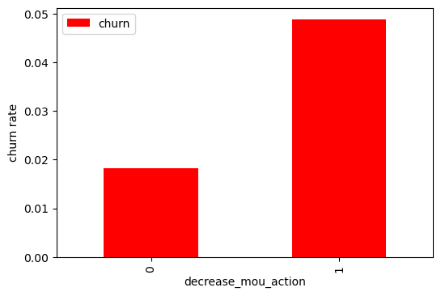
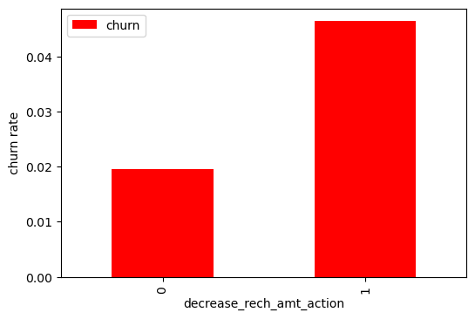
Exploratory Data Analysis: Univariate Analysis
Churn rate is more for the customers where mins of usage has decreased in the action phase
Churn rate is more for the customers where volume based cost action month is increased i.e customers do no prefer to do monthly recharges when they are in action phase

Slide 8
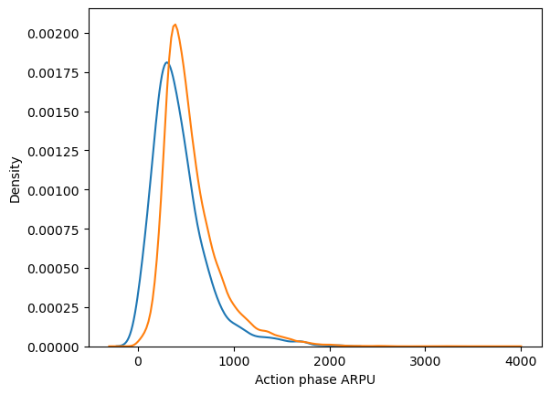
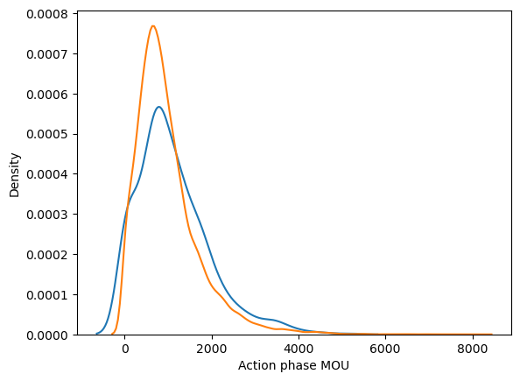
Exploratory Data Analysis: Univariate Analysis
Average revenue per user (ARPU) for the churned customers is mostly densed on the 0 to 900. The higher ARPU customers are less likely to be churned.
ARPU for the not churned customers is mostly dense on the 0 to 1000.
Minutes of usage(MOU) of the churn customers is mostly populated on the 0 to 2500 range. Higher the MOU, lesser the churn probability.

Slide 9
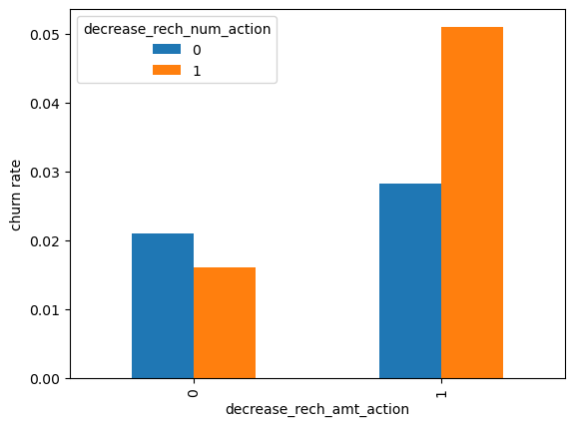
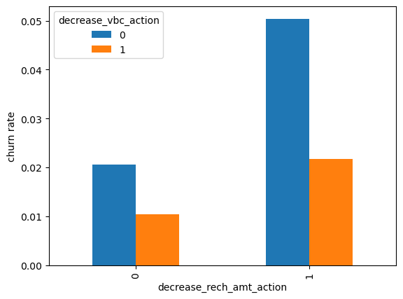
Exploratory Data Analysis: Bivariate Analysis
From the above plot it is observed the churn rate is more where recharge amt as well as no. of recharges have decreased in action phase
It is observed, the churn rate for customers is more where recharge amt is decreased along with vol based cost increased in action mth

Slide 10
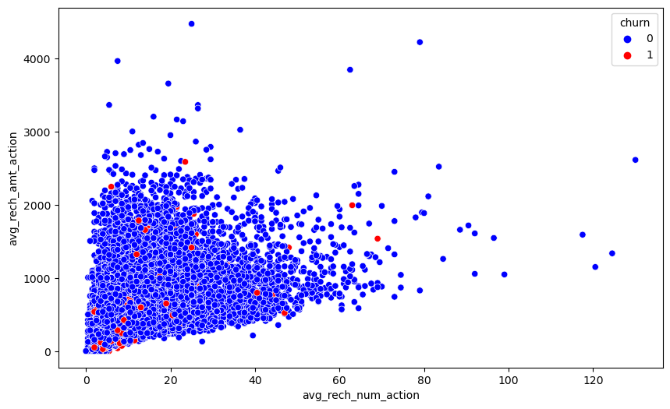
Exploratory Data Analysis: Bivariate Analysis
From the scatterplot, it is observed that rchrg no & recharge amt is mostly proportional. More the no. of recharge more the amt of recharge

Slide 11
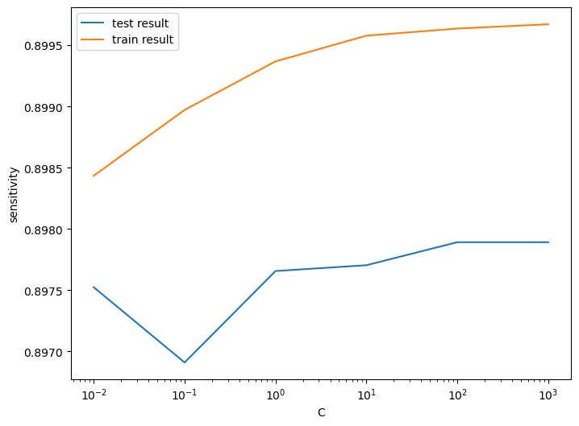
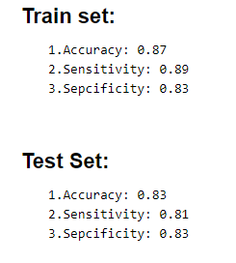
R
Model Building
Models Built
Model with PCA
Logistic Regression with PCA
Decision Tree with PCA
Random Forest with PCA
Logistic Regression without PCA with fine & coarse tuning through RFE

Slide 12
R
Model Evaluation & Selection
Strategy Applied
Calculated accuracy, sensitivity & specificity for the all the models
After careful examination model, it is concluded that simple Logistic Regression model with PCA is viable
Confusion Matrix -Train Set
Model Performance
 | Predicted Positive | Predicted Negative
Actual Positive | 17,908 | 3,517
Actual Negative | 2,154 | 19,271
Accuracy | 86.76%
Sensitivity | 89.94%
Specificity | 83.58%

Slide 13
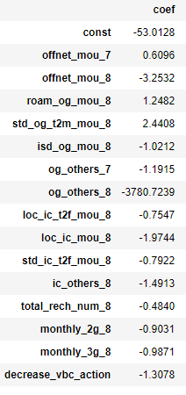
R
Model Prediction
Top Features
Confusion Matrix -Test Set
Model Performance
 | Predicted Positive | Predicted Negative
Actual Positive | 4,452 | 896
Actual Negative | 36 | 157
Accuracy | 83.17%
Sensitivity | 81.34%
Specificity | 83.24%

Slide 14
Conclusions
Out of all the models, logistic Regression model with PCA is viable since it exhibits good accuracy, sensitivity and specificity as well as is a light model.
Prediction
Accuracy For Train Data- 86.76%
For Test Data- 83.17%
Model Performance
Offnet_mou_7
Offnet_mou_8
roam_og_mou_8
Top 3 Variables

Slide 15
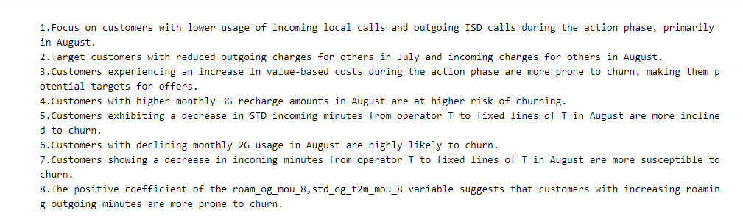
Business Recommendations

